Slide 1

Cryptography and Network Security
Fifth Edition
by William Stallings
Lecture slides by Lawrie Brown
Adapted by G. Ianni for the Network and Computer Security course at Università della Calabria
Notes:
Lecture slides by Lawrie Brown for “Cryptography and Network Security”, 5/e, by William Stallings, Chapter 2 – “Classical Encryption Techniques”.

Slide 3


Ragionamento tonto del giorno
«Hai molto bisogno che gli altri ti apprezzino e ti stimino eppure hai una tendenza a essere critico nei confronti di te stessa. Pur avendo alcune debolezze nel carattere, sei generalmente in grado di porvi rimedio. Hai molte capacità inutilizzate che non hai volto a tuo vantaggio. Disciplinata e controllata all'esterno, tendi a essere preoccupata e insicura dentro di te. A volte dubiti seriamente di aver preso la giusta decisione o di aver fatto la cosa giusta. Preferisci una certa dose di cambiamento e varietà e ti senti insoddisfatta se obbligata a restrizioni e limitazioni. Ti vanti di essere indipendente nelle tue idee e di non accettare le opinioni degli altri senza una prova che ti soddisfi. Ma hai scoperto che è imprudente essere troppo sinceri nel rivelarsi agli altri. A volte sei estroversa, affabile, socievole, mentre altre volte sei introversa, diffidente e riservata. Alcune delle tue aspirazioni tendono a essere davvero irrealistiche.»
«Hai molto bisogno che gli altri ti apprezzino e ti stimino eppure hai una tendenza a essere critico nei confronti di te stesso. Pur avendo alcune debolezze nel carattere, sei generalmente in grado di porvi rimedio. Hai molte capacità inutilizzate che non hai volto a tuo vantaggio. Disciplinato e controllato all'esterno, tendi a essere preoccupato e insicuro dentro di te. A volte dubiti seriamente di aver preso la giusta decisione o di aver fatto la cosa giusta. Preferisci una certa dose di cambiamento e varietà e ti senti insoddisfatto se obbligato a restrizioni e limitazioni. Ti vanti di essere indipendente nelle tue idee e di non accettare le opinioni degli altri senza una prova che ti soddisfi. Ma hai scoperto che è imprudente essere troppo sinceri nel rivelarsi agli altri. A volte sei estroverso, affabile, socievole, mentre altre volte sei introverso, diffidente e riservato. Alcune delle tue aspirazioni tendono a essere davvero irrealistiche.»

Slide 4
Symmetric Encryption
or conventional / private-key / single-key
sender and recipient share a common key
all classical encryption algorithms are private-key
was only type prior to invention of public-key in 1970’s
and by far most widely used
Classic encryption data type: text (strings of characters)
Modern encryption data type: strings of bits (often divided in blocks)
Notes:
Symmetric encryption, also referred to as conventional encryption or single-key encryption, was the only type of encryption in use prior to the development of public-key encryption in the 1970s. It remains by far the most widely used of the two types of encryption. All traditional schemes are symmetric / single key / private-key encryption algorithms, with a single key, used for both encryption and decryption. Since both sender and receiver are equivalent, either can encrypt or decrypt messages using that common key.

Slide 5
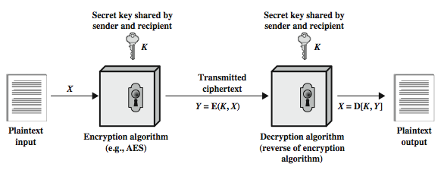
Symmetric Cipher Model
Notes:
Detail the five ingredients of the symmetric cipher model, shown in Stallings Figure 2.1:
plaintext - original message
encryption algorithm – performs substitutions/transformations on plaintext
secret key – control exact substitutions/transformations used in encryption algorithm
ciphertext - scrambled message
decryption algorithm – inverse of encryption algorithm

Slide 6
Some Basic Terminology
plaintext - original message
ciphertext - coded message
cipher - algorithm for transforming plaintext to ciphertext
key - info used in cipher known only to sender/receiver
encipher (encrypt) - converting plaintext to ciphertext
decipher (decrypt) - converting ciphertext to plaintext
cryptography - study of encryption principles/methods
cryptanalysis (codebreaking) - study of principles/ methods of deciphering ciphertext without knowing secret keys
cryptology - field of both cryptography and cryptanalysis
Notes:
Briefly review some terminology used throughout the course.

Slide 7
Cryptography
can characterize a cryptographic system by:
type of encryption operations used
substitution
transposition
product
combinations of the above
number of keys used
single-key or private
two-key or public
keyless
way in which plaintext is processed
block
stream
Notes:
Cryptographic systems can be characterized along these three independent dimensions.
The type of operations used for transforming plaintext to ciphertext. All encryption algorithms are based on two general principles: substitution, in which each element in the plaintext (bit, letter, group of bits or letters) is mapped into another element, and transposition, in which elements in the plaintext are rearranged. The fundamental requirement is that no information be lost (that is, that all operations are reversible). Most systems, referred to as product systems, involve multiple stages of substitutions and transpositions.
The number of keys used. If both sender and receiver use the same key, the system is referred to as symmetric, single-key, secret-key, or conventional encryption. If the sender and receiver use different keys, the system is referred to as asymmetric, two-key, or public-key encryption.
The way in which the plaintext is processed. A block cipher processes the input one block of elements at a time, producing an output block for each input block. A stream cipher processes the input elements continuously, producing output one element at a time, as it goes along.

Slide 8
Requirements
two requirements for secure use of symmetric encryption:
a “strong” encryption algorithm
a secret key known only to sender / receiver
mathematically we have:
Y = E(K, X)
X = D(K, Y)
assume encryption algorithm is known
implies a secure channel to distribute key
Key exchange problem
Notes:
There are two requirements for secure use of conventional encryption that mean we assume that it is impractical to decrypt a message on the basis of the cipher- text plus knowledge of the encryption/decryption algorithm, and hence do not need to keep the algorithm secret; rather we only need to keep the key secret. This feature of symmetric encryption is what makes it feasible for widespread use. It allows easy distribution of s/w and h/w implementations.
Can take a closer look at the essential elements of a symmetric encryption scheme: mathematically it can be considered a pair of functions with: plaintext X, ciphertext Y, key K, encryption algorithm E, decryption algorithm D. The intended receiver, in possession of the key, is able to invert the transformation. An opponent, observing Y but not having access to K or X, may attempt to recover X or K.

Slide 9
Attack surface of symmetric ciphers
Bruteforcing
Cryptanalysis + Statistics

Slide 10
Brute Force Search
always possible to simply try every key
most basic attack, effort proportional to key size
assume either know / recognise plaintext
See distributed.net, check openssl speed out!
Key Size (bits) | Number of Alternative Keys | Time required at 1 decryption/µs | Time required at 10⁶ decryptions/µs
32 | 2³² = 4.3 × 10⁹ | 2³¹ µs = 35.8 minutes | 2.15 milliseconds
56 | 2⁵⁶ = 7.2 × 10¹⁶ | 2⁵⁵ µs = 1142 years | 10.01 hours
128 | 2¹²⁸ = 3.4 × 10³⁸ | 2¹²⁷ µs = 5.4 × 10²⁴ years | 5.4 × 10¹⁸ years
168 | 2¹⁶⁸ = 3.7 × 10⁵⁰ | 2¹⁶⁷ µs = 5.9 × 10³⁶ years | 5.9 × 10³⁰ years
26 characters (permutation) | 26! = 4 × 10²⁶ | 2 × 10²⁶ µs = 6.4 × 10¹² years | 6.4 × 10⁶ years
Notes:
A brute-force attack involves trying every possible key until an intelligible translation of the ciphertext into plaintext is obtained. On average, half of all possible keys must be tried to achieve success. Stallings Table 2.2 shows how much time is required to conduct a brute-force attack, for various common key sizes (DES is 56, AES is 128, Triple-DES is 168, plus general mono-alphabetic cipher), where either a single system or a million parallel systems, are used.

Slide 11
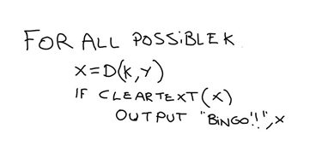
Brute-Forcing Scheme
ClearText() : guesses if X is the cleartext message based on assumptions on X’s format (language, file format, packet format, etc.)

Slide 12
Cryptanalysis
Objective is often to recover key not just single messages
Notes:
Typically objective is to recover the key in use rather then simply to recover the plaintext of a single ciphertext. There are two general approaches:
Cryptanalysis: relies on the nature of the algorithm plus perhaps some knowledge of the general characteristics of the plaintext or even some sample plaintext- ciphertext pairs. This type of attack exploits the characteristics of the algorithm to attempt to deduce a specific plaintext or to deduce the key being used.
Brute-force attacks try every possible key on a piece of ciphertext until an intelligible translation into plaintext is obtained. On average,half of all possible keys must be tried to achieve success.
If either type of attack succeeds in deducing the key, the effect is catastrophic: All future and past messages encrypted with that key are compromised.

Slide 13
Cryptanalytic Attacks
ciphertext only
only know algorithm E+D & ciphertext C: plaintext P is unknown and must be guessed
known plaintext
know/suspect plaintext P & ciphertext C
chosen plaintext
select plaintext and obtain ciphertext. Don’t know K, but can force E(K,P) to produce C (e.g. 802.11 WEP)
chosen ciphertext
select ciphertext and obtain plaintext. Don’t know K, but can force D(K,C) to produce P
chosen text
One can select plaintext or ciphertext to en/decrypt. Don’t know K but D(K,*) and E(K,*) can be called at will
Notes:
Stallings Table 2.1 summarizes the various types of cryptanalytic attacks, based on the amount of information known to the cryptanalyst, from least to most. The most difficult problem is presented when all that is available is the ciphertext only. In some cases, not even the encryption algorithm is known, but in general we can assume that the opponent does know the algorithm used for encryption. Then with increasing information have the other attacks. Generally, an encryption algorithm is designed to withstand a known-plaintext attack.

Slide 14
More Definitions
unconditional security
no matter how much computer power or time is available, the cipher cannot be broken since the ciphertext provides insufficient information to uniquely determine the corresponding plaintext
computational security
given limited computing resources (eg time needed for calculations is greater than age of universe), the cipher cannot be broken
“Security through obscurity” principle:
Use a cipher algorithm known only to the involved parties
Discouraged and very debated in general
Ageing:
What is thought “unbreakable” as of now() could be decrypted in a near future
Cipher agility:
Ability to switch to new ciphers when old ones are broken
Notes:
Two more definitions are worthy of note. An encryption scheme is unconditionally secure if the ciphertext generated by the scheme does not contain enough information to determine uniquely the corresponding plaintext, no matter how much ciphertext is available. An encryption scheme is said to be computationally secure if either the cost of breaking the cipher exceeds the value of the encrypted information, or the time required to break the cipher exceeds the useful lifetime of the information. Unconditional security would be nice, but the only known such cipher is the one-time pad (later).
For all reasonable encryption algorithms, we have to assume computational security where it either takes too long, or is too expensive, to bother breaking the cipher.

Slide 15
Classical Substitution Ciphers
where letters of plaintext are replaced by other letters or by numbers or symbols
or if plaintext is viewed as a sequence of bits, then substitution involves replacing plaintext bit patterns with ciphertext bit patterns
Classic: strings of text (letters from a fixed alphabet)
Modern: strings of bits (0 & 1)
Notes:
In this section and the next, we examine a sampling of what might be called classical encryption techniques. A study of these techniques enables us to illustrate the basic approaches to symmetric encryption used today and the types of cryptanalytic attacks that must be anticipated. The two basic building blocks of all encryption technique are substitution and transposition. We examine these in the next two sections. Finally, we discuss a system that combine both substitution and transposition.
A substitution technique is one in which the letters of plaintext are replaced by other letters or by numbers or symbols. If the plaintext is viewed as a sequence of bits, then substitution involves replacing plaintext bit patterns with ciphertext bit patterns.

Slide 16
Caesar Cipher
earliest known substitution cipher
by Julius Caesar
first attested use in military affairs
replaces each letter by 3rd letter on
example:
meet me after the toga party
PHHW PH DIWHU WKH WRJD SDUWB
Notes:
Substitution ciphers form the first of the fundamental building blocks. The core idea is to replace one basic unit (letter/byte) with another. Whilst the early Greeks described several substitution ciphers, the first attested use in military affairs of one was by Julius Caesar, described by him in Gallic Wars (cf. Kahn pp83-84). Still call any cipher using a simple letter shift a caesar cipher, not just those with shift 3.

Slide 17
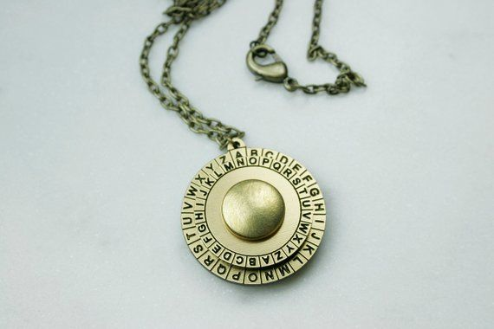
Caesar Cipher
can define transformation as:
a b c d e f g h i j k l m n o p q r s t u v w x y z
D E F G H I J K L M N O P Q R S T U V W X Y Z A B C
mathematically give each letter a number
a b c d e f g h i j k l m n o p q r s t u v w x y z
0 1 2 3 4 5 6 7 8 9 10 11 12 13 14 15 16 17 18 19 20 21 22 23 24 25
then have Caesar cipher as:
c = E(k, p) = (p + k) mod (26)
p = D(k, c) = (c – k) mod (26)
Notes:
This mathematical description uses modulo (clock) arithmetic. Here, when you reach Z you go back to A and start again. Mod 26 implies that when you reach 26, you use 0 instead (ie the letter after Z, or 25 + 1 goes to A or 0).
Example: howdy (7,14,22,3,24) encrypted using key f (ie a shift of 5) is MTBID

Slide 18
Cryptanalysis of Caesar Cipher
only have 26 possible ciphers
A maps to A,B,..Z
could simply try each in turn
a brute force search
given ciphertext, just try all shifts of letters
do need to recognize when have plaintext
eg. break ciphertext "GCUA VQ DTGCM"
Notes:
With a caesar cipher, there are only 26 possible keys, of which only 25 are of any use, since mapping A to A etc doesn't really obscure the message! Note this basic rule of cryptanalysis "check to ensure the cipher operator hasn't goofed and sent a plaintext message by mistake"!
Can try each of the keys (shifts) in turn, until can recognise the original message. See Stallings Fig 2.3 for example of search.
Note: as mentioned before, do need to be able to recognise when have an original message (ie is it English or whatever). Usually easy for humans, hard for computers. Though if using say compressed data could be much harder.
Example "GCUA VQ DTGCM" when broken gives "easy to break", with a shift of 2 (key C).

Slide 19
Monoalphabetic Cipher
rather than just shifting the alphabet
could shuffle (jumble) the letters arbitrarily
each plaintext letter maps to a different random ciphertext letter
hence key is 26 letters long
Plain: abcdefghijklmnopqrstuvwxyz
Cipher: DKVQFIBJWPESCXHTMYAUOLRGZN
Plaintext: ifwewishtoreplaceletters
Ciphertext: WIRFRWAJUHYFTSDVFSFUUFYA
Notes:
With only 25 possible keys, the Caesar cipher is far from secure. A dramatic increase in the key space can be achieved by allowing an arbitrary substitution, where the translation alphabet can be any permutation of the 26 alphabetic characters. A permutation of a finite set of elements S is an ordered sequence of all the elements of S, with each element appearing exactly once. In general, there are n! permutations of a set of n elements.
See text example of a translation alphabet, and an encrypted message using it.

Slide 20
Monoalphabetic Cipher Security
now have a total of 26! = 4 x 10²⁶ keys
with so many keys, might think is secure
but would be !!!WRONG!!!
problem is language characteristics
Notes:
Note that even given the very large number of keys, being 10 orders of magnitude greater than the key space for DES, the monoalphabetic substitution cipher is not secure, because it does not sufficiently obscure the underlying language characteristics.

Slide 21
Language Redundancy and Cryptanalysis
human languages are redundant
eg "th lrd s m shphrd shll nt wnt"
letters are not equally commonly used
in English E is by far the most common letter
followed by T,R,N,I,O,A,S
other letters like Z,J,K,Q,X are fairly rare
have tables of single, double & triple letter frequencies for various languages
Notes:
As the example shows, we don't actually need all the letters in order to understand written English text. Here vowels were removed, but they're not the only redundancy. cf written Hebrew has no vowels for same reason. Are usually familiar with "party conversations", can hear one person speaking out of hubbub of many, again because of redundancy in aural language also. This redundancy is also the reason we can compress text files, the computer can derive a more compact encoding without losing any information. Basic idea is to count the relative frequencies of letters, and note the resulting pattern.

Slide 22
One-Time Pad
if a truly random key, which is as long as the message, is used, the cipher will be unconditionally secure
called a One-Time pad
It is unbreakable since ciphertext bears no statistical relationship to the plaintext
Cannot be bruteforced, as one can’t implement cleartext(),
since for any plaintext & any ciphertext there exists a key mapping one to other
can only use the key once though
problems in generation & safe distribution of key
Quantum key distribution, DH handshake can help
Notes:
The One-Time Pad is an evolution of the Vernham cipher. An Army Signal Corp officer, Joseph Mauborgne, proposed an improvement using a random key that was truly as long as the message, with no repetitions, which thus totally obscures the original message. It produces random output that bears no statistical relationship to the plaintext. Because the ciphertext contains no information whatsoever about the plaintext, there is simply no way to break the code, since any plaintext can be mapped to any ciphertext given some key.
The one-time pad offers complete security but, in practice, has two fundamental difficulties:
There is the practical problem of making large quantities of random keys.
And the problem of key distribution and protection, where for every message to be sent, a key of equal length is needed by both sender and receiver.
Because of these difficulties, the one-time pad is of limited utility, and is useful primarily for low-bandwidth channels requiring very high security. The one-time pad is the only cryptosystem that exhibits what is referred to as perfect secrecy.

Slide 23
XOR and cryptography
Easy and reversible transformation
A XOR k = A’ ⬄ A’ XOR k = A

Slide 24
Block vs Stream Ciphers
block ciphers process messages in blocks, each of which is then en/decrypted
like a substitution on very big characters
64-bits or more
stream ciphers process messages a bit or byte at a time when en/decrypting
many current ciphers are block ciphers
better analysed
broader range of applications
Notes:
Block ciphers work a on block / word at a time, which is some number of bits. All of these bits have to be available before the block can be processed. Stream ciphers work on a bit or byte of the message at a time, hence process it as a “stream”. Block ciphers are currently better analysed, and seem to have a broader range of applications, hence focus on them.

Slide 25
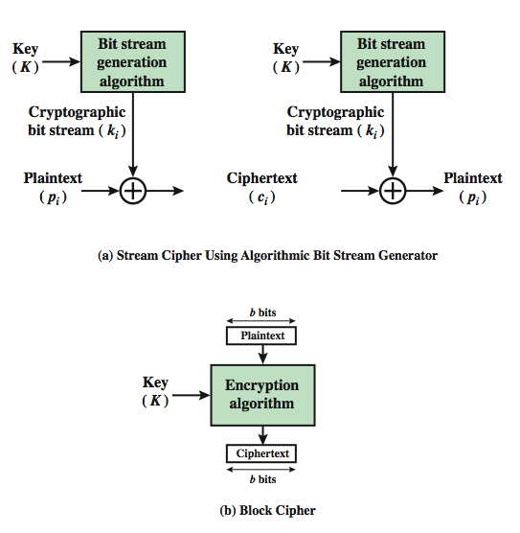
Block vs Stream Ciphers
Notes:
A block cipher is one in which a block of plaintext is treated as a whole and used to produce a ciphertext block of equal length. Typically, a block size of 64 or 128 bits is used. As with a stream cipher, the two users share a symmetric encryption key (Figure 3.1b). A stream cipher is one that encrypts a digital data stream one bit or one byte at a time. In the ideal case, a one-time pad version of the Vernam cipher would be used (Figure 2.7), in which the keystream (k ) is as long as the plaintext bit stream (p).

Slide 26
Data Encryption Standard (DES)
most widely used block cipher in world
adopted in 1977 by NBS (now NIST)
as FIPS PUB 46
encrypts 64-bit data using 56-bit key
has widespread use
has been considerable controversy over its security
Notes:
The most widely used private key block cipher, is the Data Encryption Standard (DES). It was adopted in 1977 by the National Bureau of Standards as Federal Information Processing Standard 46 (FIPS PUB 46). DES encrypts data in 64-bit blocks using a 56-bit key. The DES enjoys widespread use. It has also been the subject of much controversy its security.

Slide 27
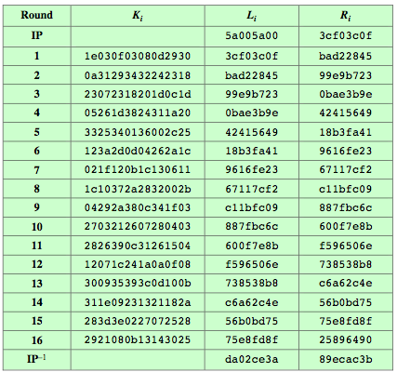
DES Example
Notes:
Can now work through an example, and consider some of its implications. In this example, the plaintext is a hexadecimal palindrome, with:
Plaintext: 02468aceeca86420
Key: 0f1571c947d9e859
Ciphertext: da02ce3a89ecac3b
Table 3.5 shows the progression of the algorithm. The first row shows the 32-bit values of the left and right halves of data after the initial permutation. The next 16 rows show the results after each round. Also shown is the value of the 48-bit subkey generated for each round. The final row shows the left and right-hand values after the inverse initial permutation. These two values combined form the ciphertext.

Slide 28
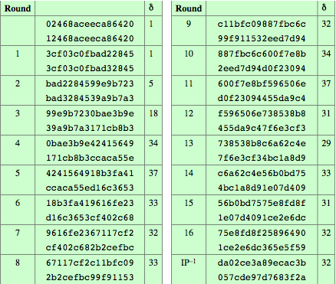
Avalanche in DES
Notes:
A desirable property of any encryption algorithm is that a small change in either the plaintext or the key should produce a significant change in the ciphertext. In particular, a change in one bit of the plaintext or one bit of the key should produce a change in many bits of the ciphertext. This is referred to as the avalanche effect. Using the example from Table 3.5, Table 3.6 shows the result when the fourth bit of the plaintext is changed, so that the plaintext is 12468aceeca86420. The second column of the table shows the intermediate 64-bit values at the end of each round for the two plaintexts. The third column shows the number of bits that differ between the two intermediate values. The table shows that after just three rounds, 18 bits differ between the two blocks. On completion, the two ciphertexts differ in 32 bit positions. Table 3.7 in the text shows a similar test using the original plaintext of with two keys that differ in only the fourth bit position. Again, the results show that about half of the bits in the ciphertext differ and that the avalanche effect is pronounced after just a few rounds.

Slide 29
Avalanche Effect
key desirable property of encryption alg
where a change of one input or key bit results in changing approx half output bits
making attempts to “home-in” by guessing keys impossible
DES exhibits strong avalanche
Notes:
A desirable property of any encryption algorithm is that a small change in either the plaintext or the key should produce a significant change in the ciphertext. In particular, a change in one bit of the plaintext or one bit of the key should produce a change in many bits of the ciphertext. If the change were small, this might provide a way to reduce the size of the plaintext or key space to be searched. DES exhibits a strong avalanche effect, as may be seen in Stallings Table 3.5.

Slide 30
Strength of DES – Key Size
56-bit keys have 2⁵⁶ = 7.2 x 10¹⁶ values
brute force search looks hard
recent advances have shown is possible
in 1997 on Internet in a few months
in 1998 on dedicated h/w (EFF) in a few days
in 1999 above combined in 22hrs!
still must be able to recognize plaintext
DES is nowadays OBSOLETE
Notes:
Since its adoption as a federal standard, there have been lingering concerns about the level of security provided by DES in two areas: key size and the nature of the algorithm.
With a key length of 56 bits, there are 2⁵⁶ possible keys, which is approximately 7.2*10¹⁶ keys. Thus a brute-force attack appeared impractical.
However DES was finally and definitively proved insecure in July 1998, when the Electronic Frontier Foundation (EFF) announced that it had broken a DES encryption using a special-purpose "DES cracker" machine that was built for less than $250,000. The attack took less than three days. The EFF has published a detailed description of the machine, enabling others to build their own cracker [EFF98].
There have been other demonstrated breaks of the DES using both large networks of computers & dedicated h/w, including:
- 1997 on a large network of computers in a few months
- 1998 on dedicated h/w (EFF) in a few days
- 1999 above combined in 22hrs!
It is important to note that there is more to a key-search attack than simply running through all possible keys. Unless known plaintext is provided, the analyst must be able to recognize plaintext as plaintext.
Clearly must now consider alternatives to DES, the most important of which are AES and triple DES.

Slide 31
Strength of DES – Analytic Attacks
now have several analytic attacks on DES
these utilise some deep structure of the cipher
by gathering information about encryptions
can eventually recover some/all of the sub-key bits
if necessary then exhaustively search for the rest
generally these are statistical attacks
differential cryptanalysis
linear cryptanalysis
related key attacks
Notes:
Another concern is the possibility that cryptanalysis is possible by exploiting the characteristics of the DES algorithm. The focus of concern has been on the eight substitution tables, or S-boxes, that are used in each iteration. These techniques utilise some deep structure of the cipher by gathering information about encryptions so that eventually you can recover some/all of the sub-key bits, and then exhaustively search for the rest if necessary. Generally these are statistical attacks which depend on the amount of information gathered for their likelihood of success. Attacks of this form include differential cryptanalysis. linear cryptanalysis, and related key attacks.

Slide 32
Origins of AES
clear a replacement for DES was needed
have theoretical attacks that can break it
have demonstrated exhaustive key search attacks
can use Triple-DES – but slow, has small blocks
US NIST issued call for ciphers in 1997
15 candidates accepted in Jun 98
5 were shortlisted in Aug-99
Rijndael was selected as the AES in Oct-2000
issued as FIPS PUB 197 standard in Nov-2001
Notes:
The Advanced Encryption Standard (AES) was published by NIST (National Institute of Standards and Technology) in 2001. AES is a symmetric block cipher that is intended to replace DES as the approved standard for a wide range of applications. The AES cipher (& other candidates) form the latest generation of block ciphers, and now we see a significant increase in the block size - from the old standard of 64-bits up to 128-bits; and keys from 128 to 256-bits. In part this has been driven by the public demonstrations of exhaustive key searches of DES. Whilst triple-DES is regarded as secure and well understood, it is slow, especially in s/w. In a first round of evaluation, 15 proposed algorithms were accepted. A second round narrowed the field to 5 algorithms. NIST completed its evaluation process and published a final standard (FIPS PUB 197) in November of 2001. NIST selected Rijndael as the proposed AES algorithm. The two researchers who developed and submitted Rijndael for the AES are both cryptographers from Belgium: Dr. Joan Daemen and Dr.Vincent Rijmen.

Slide 33
The AES Cipher - Rijndael
designed by Rijmen-Daemen in Belgium
has 128/192/256 bit keys, 128 bit data
an iterative rather than feistel cipher
processes data as block of 4 columns of 4 bytes
operates on entire data block in every round
designed to be:
resistant against known attacks
speed and code compactness on many CPUs. Easy to be implemented on hardware and software. Can be parallelized
Implementations hard to be attacked
“Agile” key switching
design simplicity
Notes:
The Rijndael proposal for AES defined a cipher in which the block length and the key length can be independently specified to be 128,192,or 256 bits. The AES specification uses the same three key size alternatives but limits the block length to 128 bits. Rijndael is an academic submission, based on the earlier Square cipher, from Belgium academics Dr Joan Daemen and Dr Vincent Rijmen. It is an iterative cipher (operates on entire data block in every round) rather than feistel (operate on halves at a time), and was designed to have characteristics of: Resistance against all known attacks, Speed and code compactness on a wide range of platforms, & Design simplicity.

Slide 34
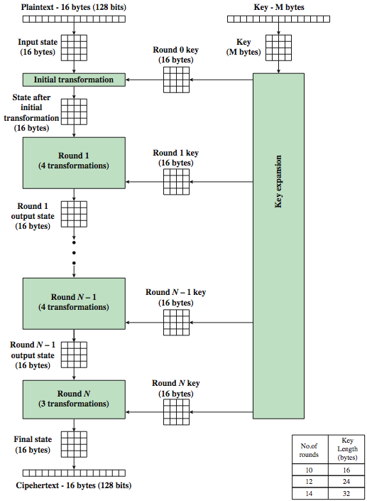
AES Encryption Process
Notes:
Stallings Figure 5.1 shows the overall encryption process in AES.

Slide 35
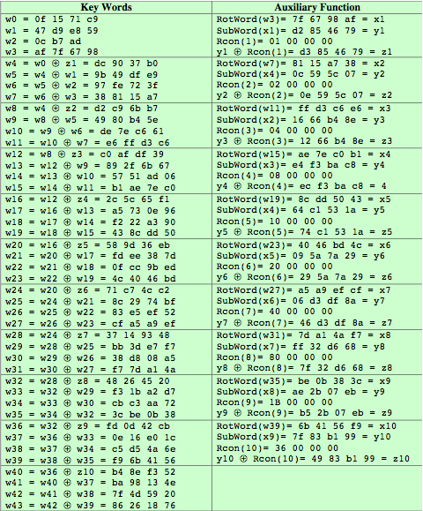
AES Example Key Expansion
Notes:
We now work through an example, and consider some of its implications. The plaintext, key, and resulting ciphertext are as follows:
Plaintext: 0123456789abcdeffedcba9876543210
Key: 0f1571c947d9e8590cb7add6af7f6798
Ciphertext: ff0b844a0853bf7c6934ab4364148fb9
Table 5.3 shows the expansion of the 16-byte key into 10 round keys. As previously explained, this process is performed word by word, with each four-byte word occupying one column of the word round key matrix. The left hand column shows the four round key words generated for each round. The right hand column shows the steps used to generate the auxiliary word used in key expansion. We begin, of course, with the key itself serving as the round key for round 0.

Slide 36
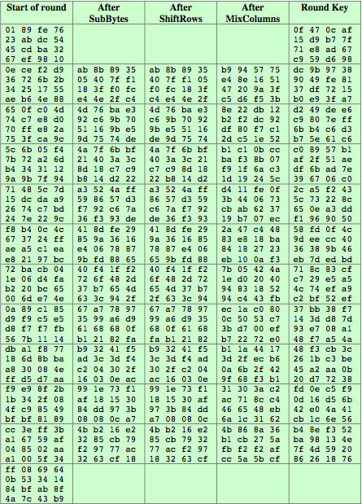
AES Example Encryption
Notes:
Next, Table 5.4 shows the progression of the state matrix through the AES encryption process. The first column shows the value of the state matrix at the start of a round. For the first row, the state matrix is just the matrix arrangement of the plaintext. The second, third, and fourth columns show the value of the state matrix for that round after the SubBytes, ShiftRows, and MixColumns transformations, respectively. The fifth column shows the round key. You can verify that these round keys equate with those shown in Table 5.3. The first column shows the value of the state matrix resulting from the bitwise XOR of the state after the preceding MixColumns with the round key for the preceding round.

Slide 37
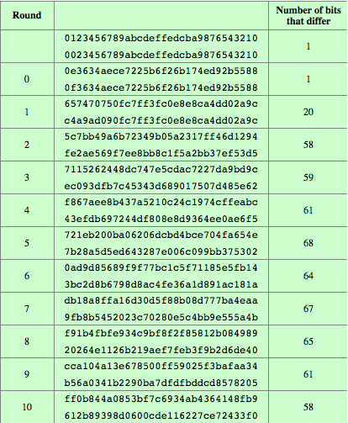
AES Example Avalanche
Notes:
In any good cipher design, want the avalanche effect, in which a small change in plaintext or key produces a large change in the ciphertext. Using the example from Table 5.4, Table 5.5 shows the result when the eighth bit of the plaintext is changed. The second column of the table shows the value of the state matrix at the end of each round for the two plaintexts. Note that after just one round, 20 bits of the state vector differ. And after two rounds, close to half the bits differ. This magnitude of difference propagates through the remaining rounds. A bit difference in approximately half the positions in the most desirable outcome.

Slide 38
Implementation Aspects
can efficiently implement on 32-bit CPU
redefine steps to use 32-bit words
can precompute 4 tables of 256-words
then each column in each round can be computed using 4 table lookups + 4 XORs
at a cost of 4Kb to store tables
designers believe this very efficient implementation was a key factor in its selection as the AES cipher
Available in Intel hardware (AES-NI instructions)
Notes:
AES can also be very efficiently implemented on an 32-bit processor, by rewriting the stage transformation to use 4 table lookups & 4 XOR’s per column of state. These tables can be computed in advance using the formulae shown in the text, and need 4Kb to store.
The developers of Rijndael believe that this compact, efficient implementation was probably one of the most important factors in the selection of Rijndael for AES.

Slide 39
Other symmetric BLOCK ciphers
ARIA (AES-based), LEA, SEED - S. Korea
Camellia - Japan, NTT+Mitsubishi, EU recommended
CAST5, IDEA (PGP)
Blowfish, twofish
Sm4 – China
GOST - Russia
Stream ciphers (more later): RC4, CHACHA

Slide 40
Chapter 6 – Block Cipher Operation
Many savages at the present day regard their names as vital parts of themselves, and therefore take great pains to conceal their real names, lest these should give to evil-disposed persons a handle by which to injure their owners.
— The Golden Bough, Sir James George Frazer
Notes:
Opening quote.

Slide 41
Double-DES?
could use 2 DES encrypts on each block
C = E_{K2}(E_{K1}(P))
issue of reduction to single stage
and have “meet-in-the-middle” attack, with known P and C
works whenever one uses a cipher twice
since X = E_{K1}(P) = D_{K2}(C)
attack by encrypting P with all keys and store them
then decrypt C with all possible keys and match X value
can show it takes O(2⁵⁶) steps and not O(2¹¹²)
Notes:
The simplest form of multiple encryption has two encryption stages and two keys - Double-DES.
Have concern that there might be a single key that is equivalent to using 2 keys as above, not likely but only finally proved as impossible in 1992.
More seriously have the “meet-in-the-middle” attack, first described by Diffie in 1977. It is a known plaintext attack (ie have know pair (P,C), and attempts to find by trial-and-error a value X in the “middle” of the double-DES encryption of this pair, and chances of this are much better at O(2^56) than exhaustive search at O(2^112).

Slide 42
Triple-DES with Two-Keys
hence must use 3 encryptions
would seem to need 3 distinct keys
but can use 2 keys with E-D-E sequence
C = E_{K1}(D_{K2}(E_{K1}(P)))
nb encrypt & decrypt equivalent in security
if K1=K2 then can work with single DES
standardized in ANSI X9.17 & ISO8732
Notes:
Triple-DES with two keys is a popular alternative to single-DES, but suffers from being 3 times slower to run. The use of encryption & decryption stages are equivalent, but the chosen structure allows for compatibility with single-DES implementations. 3DES with two keys is a relatively popular alternative to DES and has been adopted for use in the key management standards ANS X9.17 and ISO 8732. Currently, there are no practical cryptanalytic attacks on 3DES. Coppersmith notes that the cost of a brute-force key search on 3DES is on the order of 2^112 (=5*10^33) and estimates that the cost of differential cryptanalysis suffers an exponential growth, compared to single DES, exceeding 10^52.
There are several proposed attacks on 3DES that, although not currently practical, give a flavor for the types of attacks that have been considered and that could form the basis for more successful future attacks. See text for details.

Slide 43
Triple-DES with Three-Keys
can use Triple-DES with Three-Keys to avoid even these
C = E_{K3}(D_{K2}(E_{K1}(P)))
has been adopted by some Internet applications, eg PGP, S/MIME
Deprecated by NIST in 2017
Security key length equivalence:
80 bits (instead of 168)
Notes:
Although the attacks currently known appear impractical, anyone using two-key 3DES may feel some concern. Thus, many researchers now feel that three-key 3DES is the preferred alternative. Three-key 3DES has an effective key length of 168 bits and is defined as shown. A number of Internet-based applications have adopted three-key 3DES, including PGP and S/MIME.

Slide 44
Modes of Operation
block ciphers encrypt fixed size blocks
eg. DES encrypts 64-bit blocks with 56-bit key
need some way to en/decrypt arbitrary amounts of data in practise
NIST SP 800-38A defines 5 modes
have block and stream modes
to cover a wide variety of applications
can be used with any block cipher
Notes:
DES (or any block cipher) forms a basic building block, which en/decrypts a fixed sized block of data. However to use these in practise, we usually need to handle arbitrary amounts of data, which may be available in advance (in which case a block mode is appropriate), and may only be available a bit/byte at a time (in which case a stream mode is used). To apply a block cipher in a variety of applications, five "modes of operation" have been defined by NIST (SP 800-38A). In essence, a mode of operation is a technique for enhancing the effect of a cryptographic algorithm or adapting the algorithm for an application, such as applying a block cipher to a sequence of data blocks or a data stream. The five modes are intended to cover a wide variety of applications of encryption for which a block cipher could be used. These modes are intended for use with any symmetric block cipher, including triple DES and AES. .

Slide 45
Electronic Codebook Book (ECB)
message is broken into independent blocks which are encrypted
each block is a value which is substituted, like a codebook, hence name
each block is encoded independently of the other blocks
C_{i} = E_{K}(P_{i})
uses: secure transmission of single values
Notes:
The simplest mode is the electronic codebook (ECB) mode, in which plaintext is handled one block at a time and each block of plaintext is encrypted using the same key. The term codebook is used because, for a given key, there is a unique ciphertext for every b-bit block of plaintext. Therefore, we can imagine a gigantic codebook in which there is an entry for every possible b-bit plaintext pattern showing its corresponding ciphertext. For a message longer than b bits, the procedure is simply to break the message into b-bit blocks, padding the last block if necessary. Decryption is performed one block at a time, always using the same key. ECB is the simplest of the modes, and is used when only a single block of info needs to be sent (eg. a session key encrypted using a master key).

Slide 46
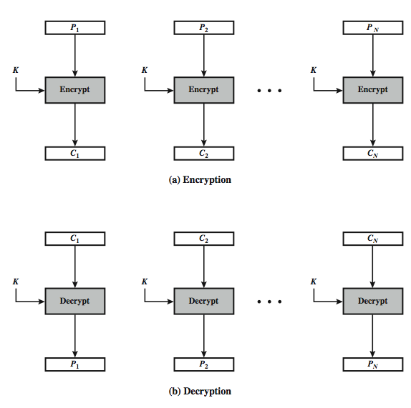
Electronic Codebook Book (ECB)
Notes:
Stallings Figure 6.3 illustrates the Electronic Codebook (ECB) Mode.

Slide 47
Advantages and Limitations of ECB
message repetitions may show in ciphertext
if aligned with message block
particularly with data such graphics
or with messages that change very little, which become a code-book analysis problem
weakness is due to the encrypted message blocks being independent
main use is sending a few blocks of data
Notes:
For lengthy messages, the ECB mode may not be secure. If the message is highly structured, it may be possible for a cryptanalyst to exploit these regularities. If the message has repetitive elements, with a period of repetition a multiple of b bits, then these elements can be identified by the analyst. This may help in the analysis or may provide an opportunity for substituting or rearranging blocks. Hence ECB is not appropriate for any quantity of data, since repetitions can be seen, esp. with graphics, and because the blocks can be shuffled/inserted without affecting the en/decryption of each block. Its main use is to send one or a very few blocks, eg a session encryption key.

Slide 48
Cipher Block Chaining (CBC)
message is broken into blocks
linked together in encryption operation
each previous cipher blocks is chained with current plaintext block, hence name
use Initial Vector (IV) to start process
C_{i} = E_{K}(P_{i} XOR C_{i-1})
C₋₁ = IV
uses: bulk data encryption, authentication, TCP
Notes:
To overcome the problems of repetitions and order independence in ECB, want some way of making the ciphertext dependent on all blocks before it. The CBC provides this, by combining the previous ciphertext block with the current message block before encrypting. In effect, we have chained together the processing of the sequence of plaintext blocks. The input to the encryption function for each plaintext block bears no fixed relationship to the plaintext block. Therefore, repeating patterns of b bits are not exposed. For decryption, each cipher block is passed through the decryption algorithm. The result is XORed with the preceding ciphertext block to produce the plaintext block. To produce the first block of ciphertext, an initialization vector (IV) is XORed with the first block of plaintext. On decryption, the IV is XORed with the output of the decryption algorithm to recover the first block of plaintext. The IV is a data block that is that same size as the cipher block, and is either well known (often all 0's), or otherwise is sent, ECB encrypted, just before starting CBC use. CBC mode is applicable whenever large amounts of data need to be sent securely, provided that all data is available in advance (eg email, FTP, web etc).

Slide 49
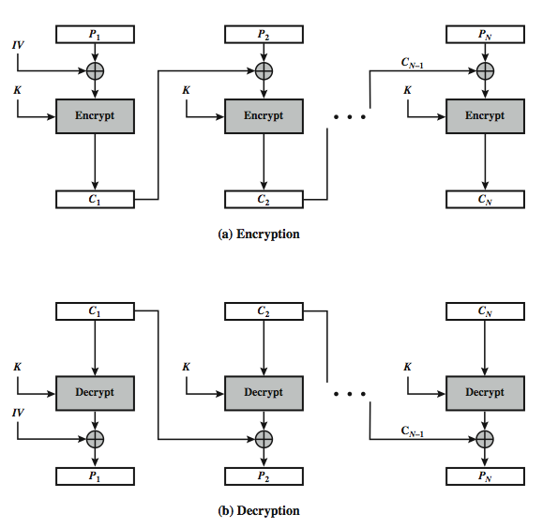
Cipher Block Chaining (CBC)
Notes:
Stallings Figure 6.4 illustrates the Cipher Block Chaining (CBC) Mode.

Slide 50
Message Padding
at end of message must handle a possible last short block
which is not as large as blocksize of cipher
pad either with known non-data value (eg nulls)
or pad last block along with count of pad size
eg. [ b1 b2 b3 0 0 0 0 5]
means have 3 data bytes, then 5 bytes pad+count
this may require an extra entire block over those in message
there are other, more esoteric modes, which avoid the need for an extra block
Bad Padding + CBC = Problems (see BEAST attack)
Notes:
One issue that arises with block modes is how to handle the last block, which may well not be complete. In general have to pad this block (typically with 0's), and then must recognise padding at other end - may be obvious (eg in text the 0 value should usually not occur), or otherwise must explicitly have the last byte as a count of how much padding was used (including the count). Note that if this is done, if the last block IS an even multiple of 8 bytes or has exactly the same form as pad+count, then will have to add an extra block, all padding so as to have a count in the last byte. There are other, more esoteric, “ciphertext stealing” modes, which avoid the need for an extra block.

Slide 51
Advantages and Limitations of CBC
a ciphertext block depends on all blocks before it
any change to a block affects all following ciphertext blocks
need Initialization Vector (IV)
which must be known to sender & receiver
if sent in clear, an attacker can change bits of first block, and change IV to compensate
hence IV must either be a fixed value (as in EFTPOS)
or must be sent encrypted in ECB mode before the rest of message
Notes:
CBC is the block mode generally used. The chaining provides an avalanche effect, which means the encrypted message cannot be changed or rearranged without totally destroying the subsequent data. However there is the issue of ensuring that the IV is either fixed or sent encrypted in ECB mode to stop attacks on 1st block.

Slide 52
Output FeedBack (OFB)
message is treated as a stream of bits
output of cipher is added to message
output is then feed back (hence name)
feedback is independent of message
can be computed in advance
O_{i} = E_{K}(O_{i-1})
C_{i} = P_{i} XOR O_{i}
O₋₁ = IV
uses: stream encryption on noisy channels, UDP
Notes:
An alternative to CFB is OFB. Here the generation of the "random" bits is independent of the message being encrypted. The output feedback (OFB) mode is similar in structure to that of CFB, except that the output of the encryption function is fed back to the shift register in OFB, whereas in CFB the ciphertext unit is fed back to the shift register. The other difference is that the OFB mode operates on full blocks of plaintext and ciphertext, not on an s-bit subset. The advantage is that firstly, they can be computed in advance, which is good for bursty traffic, and secondly, any bit error only affects a single bit. Thus this is good for noisy links (eg satellite TV transmissions etc).

Slide 53
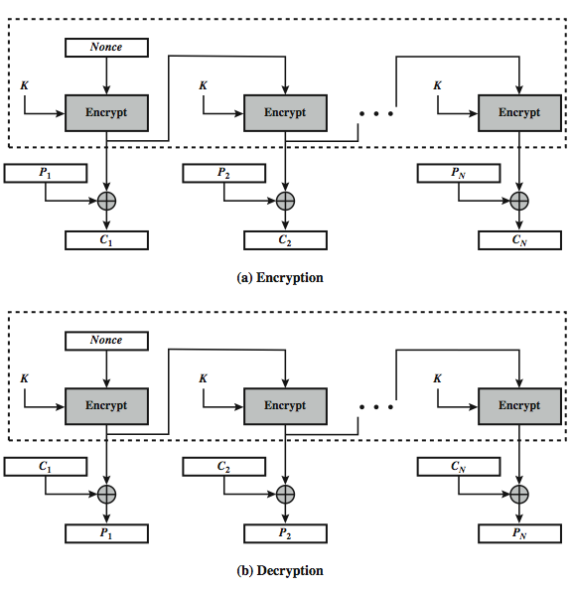
Output FeedBack (OFB)
Notes:
Stallings Figure 6.6 illustrates the Output FeedBack (OFB) Mode.

Slide 54
Advantages and Limitations of OFB
needs an IV which is unique for each use
if ever reuse attacker can recover outputs
bit errors do not propagate
more vulnerable to message stream modification
sender & receiver must remain in sync
only use with full block feedback
subsequent research has shown that only full block feedback (ie OFB-64 or OFB-128) should ever be used
Notes:
As with CBC and CFB, the OFB mode requires an initialization vector. In the case of OFB, the IV must be a nonce; that is, the IV must be unique to each execution of the encryption operation. The reason for this is that the sequence of encryption output blocks, Oi. , depends only on the key and the IV, and does not depend on the plaintext. Therefore, for a given key and IV, the stream of output bits used to XOR with the stream of plaintext bits is fixed. If two different messages had an identical block of plaintext in the identical position, then an attacker would be able to determine that portion of the O stream.
One advantage of the OFB method is that bit errors in transmission do not propagate. The disadvantage of OFB is that it is more vulnerable to a message stream modification attack than is CFB.
OFB has the structure of a typical stream cipher, in that the cipher generates a stream of bits as a function of an initial value and a key, and that stream of bits is XORed with the plaintext bits. Hence the sender & receiver need to remain in sync, or all data is lost. Also, research has shown that you should only ever use a full block feedback ie OFB-64/128 mode. Hence OFB encrypts plaintext a full block at a time, where typically a block is 64 or 128 bits.

Slide 55
Counter (CTR)
a “new” mode, though proposed early on
similar to OFB but encrypts counter value rather than any feedback value
must have a different key & counter value for every plaintext block (never reused)
O_{i} = E_{K}(i)
C_{i} = P_{i} XOR O_{i}
uses: high-speed network encryptions, UDP
Notes:
The Counter (CTR) mode is a variant of OFB, but which encrypts a counter value (hence name). Although it was proposed many years before, it has only recently been standardized for use with AES along with the other existing 4 modes. It is being used with applications in ATM (asynchronous transfer mode) network security and IPSec (IP security). A counter, equal to the plaintext block size is used. The only requirement stated in SP 800-38A is that the counter value must be different for each plaintext block that is encrypted. Typically the counter is initialized to some value and then incremented by 1 for each subsequent block. As with the OFB mode, the initial counter value must be a nonce; be different for all of the messages encrypted using the same key. Further, all counter values across all messages must be unique. If, contrary to this requirement, a counter value is used multiple times, then the confidentiality of all of the plaintext blocks corresponding to that counter value may be compromised.

Slide 56
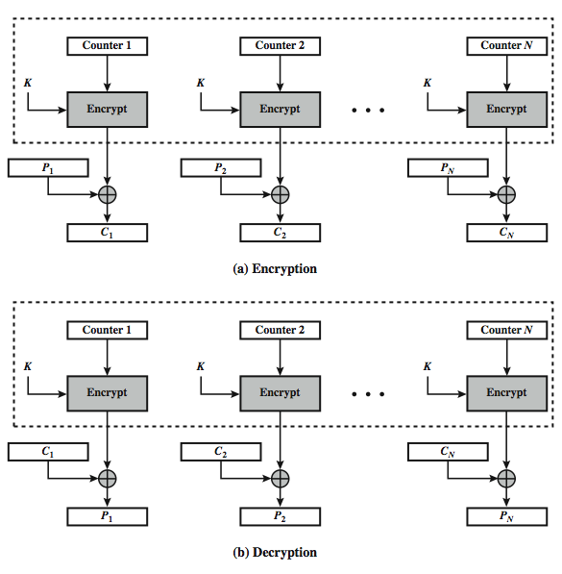
Counter (CTR)
Notes:
Stallings Figure 6.7 illustrates the Counter (CTR) Mode.

Slide 57
Advantages and Limitations of CTR
efficiency
can do parallel encryptions in h/w or s/w
can preprocess in advance of need
good for bursty high speed links
random access to encrypted data blocks
provable security (good as other modes)
but must ensure never reuse key/counter values, otherwise could break (cf OFB)
Notes:
CTR mode has a number of advantages in parallel h/w & s/w efficiency, can preprocess the output values in advance of needing to encrypt, can get random access to encrypted data blocks, and is simple. But like OFB have issue of not reusing the same key+counter value.

Slide 58
XTS-AES Mode
new mode, for block oriented storage use
in IEEE Std 1619-2007
concept of tweakable block cipher
different requirements to transmitted data
uses AES twice for each block
T_{j} = E_{K2}(i) XOR α^{j}
C_{j} = E_{K1}(P_{j} XOR T_{j}) XOR T_{j}
where i is tweak & j is sector no
each sector may have multiple blocks
Notes:
NIST is currently in the process of approving an additional block cipher mode of operation, XTS-AES. This mode is also an IEEE standard, IEEE Std 1619-2007, which describes a method of encryption for data stored in sector-based devices. The XTS-AES mode is based on the concept of a tweakable block cipher. The requirements for encrypting stored data, also referred to as "data at rest" differ somewhat from those for transmitted data (see text for list). Encryption of a single block involves two instances of the AES algorithm with two keys, and a number of parameters (see text). In essence, the parameter j is the block number within the sector, and i is the 128-bit tweak for the sector. Each data unit (sector) is assigned a tweak value that is a nonnegative integer. The tweak values are assigned consecutively, starting from an arbitrary nonnegative integer.
The plaintext of a sector or data unit is organized in to blocks of 128 bits, hence the input to the XTS-AES algorithm consists of m 128-bit blocks and possibly a final partial block. For encryption and decryption, each block is treated independently and encrypted. The only exception occurs when the last block has less than 128 bits. In that case, the last two blocks are encrypted/decrypted using a ciphertext- stealing technique instead of padding.

Slide 59
Summary
Multiple Encryption & Triple-DES
Modes of Operation
ECB, CBC, CFB, OFB, CTR, XTS-AES
Notes:
Chapter 6 summary.

Slide 60
Chapter 7 – Stream Ciphers and Random Number Generation
The comparatively late rise of the theory of probability shows how hard it is to grasp, and the many paradoxes show clearly that we, as humans, lack a well grounded intuition in this matter.
In probability theory there is a great deal of art in setting up the model, in solving the problem, and in applying the results back to the real world actions that will follow.
— The Art of Probability, Richard Hamming
Notes:
Opening quote.

Slide 61
Random Numbers
many uses of random numbers in cryptography
nonces in authentication protocols to prevent replay
session keys
public key generation
keystream for a one-time pad
in all cases its critical that these values be
statistically random, uniform distribution, independent
unpredictability of future values from previous values
true random numbers provide this
care needed with generated random numbers
Notes:
Random numbers play an important role in the use of encryption for various network security applications. In this section, we provide a brief overview of the use of random numbers in cryptography and network security and then focus on the principles of pseudorandom number generation. Getting good random numbers is important, but difficult. You don't want someone guessing the key you're using to protect your communications because your "random numbers" weren't (as happened in an early release of Netscape SSL). Traditionally, the concern in the generation of a sequence of allegedly random numbers has been that the sequence of numbers be random in some well-defined statistical sense (with uniform distribution & independent). In applications such as reciprocal authentication, session key generation, and stream ciphers, the requirement is not just that the sequence of numbers be statistically random but that the successive members of the sequence are unpredictable (so that it is not possible to predict future values having observed previous values). With "true" random sequences, each number is statistically independent of other numbers in the sequence and therefore unpredictable. However, as is discussed shortly, true random numbers are seldom used; rather, sequences of numbers that appear to be random are generated by some algorithm.

Slide 62
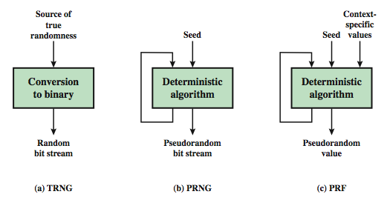
Random & Pseudorandom Number Generators
Notes:
Stallings Figure 7.1 contrasts a true random number generator (TRNG) with two forms of pseudorandom number generators. A TRNG takes as input a source that is effectively random; the source is often referred to as an entropy source. In contrast, a PRNG takes as input a fixed value, called the seed, and produces a sequence of output bits using a deterministic algorithm. Typically, as shown, there is some feedback path by which some of the results of the algorithm are fed back as input as additional output bits are produced. The important thing to note is that the output bit stream is determined solely by the input value or values, so that an adversary who knows the algorithm and the seed can reproduce the entire bit stream.
Figure 7.1 shows two different forms of PRNGs, based on application;
• Pseudorandom number generator: An algorithm that is used to produce an open-ended sequence of bits is referred to as a PRNG. A common application for an open-ended sequence of bits is as input to a symmetric stream cipher, as discussed in Section 7.4. Also, see Figure 3.1a.
• Pseudorandom function (PRF): A PRF is used to produced a pseudorandom string of bits of some fixed length. Examples are the symmetric encryption keys and nonces. Typically, the PRF takes as input a seed plus some context specific values, such as a user ID or an application ID.

Slide 63
Natural Random Noise
best source is natural randomness in real world
find a regular but random event and monitor
do generally need special h/w to do this
eg. radiation counters, radio noise, audio noise, thermal noise in diodes, leaky capacitors, mercury discharge tubes etc
starting to see such h/w in new CPU's
problems of bias or uneven distribution in signal
have to compensate for this when sample, often by passing bits through a hash function
best to only use a few noisiest bits from each sample
RFC4086 recommends using multiple sources + hash
Notes:
A true random number generator (TRNG) uses a nondeterministic source to produce randomness. Most operate by measuring unpredictable natural processes, such as pulse detectors of ionizing radiation events, gas discharge tubes, and leaky capacitors. Special hardware is usually needed for this. A true random number generator may produce an output that is biased in some way. Various methods of modifying a bit stream to reduce or eliminate the bias have been developed. These are referred to as deskewing algorithms. One approach to deskew is to pass the bit stream through a hash function such as MD5 or SHA-1. RFC 4086 recommends collecting input from multiple hardware sources and then mixing these using a hash function to produce random output.

Slide 64
Published Sources
a few published collections of random numbers
Rand Co, in 1955, published 1 million numbers
generated using an electronic roulette wheel
has been used in some cipher designs cf Khafre
earlier Tippett in 1927 published a collection
issues are that:
these are limited
too well-known for most uses
Notes:
Another alternative is to dip into a published collection of good-quality random numbers (e.g., [RAND55], [TIPP27]). However, these collections provide a very limited source of numbers compared to the potential requirements of a sizable network security application. But they can be of use in the design of random tables for cryptographic functions (cf. Khafre). Furthermore, although the numbers in these books do indeed exhibit statistical randomness, they are predictable because an opponent who knows that the book is in use can obtain a copy.

Slide 65
Pseudorandom Number Generators (PRNGs)
often use deterministic algorithmic techniques to create “random numbers”
although they are not truly random
can pass many tests of “randomness”
known as “pseudorandom numbers”
created by “Pseudorandom Number Generators (PRNGs)”
Notes:
Cryptographic applications typically make use of deterministic algorithmic techniques for random number generation, producing sequences of numbers that are not statistically random, but if the algorithm is good, the resulting sequences will pass many reasonable tests of randomness. Such numbers are referred to as pseudorandom numbers, created by “Pseudorandom Number Generators (PRNGs)”.

Slide 66
PRNG Requirements
randomness
uniformity, scalability, consistency
unpredictability
forward & backward unpredictability
use same tests to check
characteristics of the seed
secure
if known adversary can determine output
so must be random or pseudorandom number
Notes:
When a PRNG or PRF is used for a cryptographic application, then the basic requirement is that an adversary who does not know the seed is unable to determine the pseudorandom string. This general requirement for secrecy of the output of a PRNG or PRF leads to specific requirements in the areas of randomness, unpredictability, and the characteristics of the seed.
In terms of randomness, the requirement for a PRNG is that the generated bit stream appear random even though it is deterministic. NIST SP 800-22 (A Statistical Test Suite for Random and Pseudorandom Number Generators for Cryptographic Applications) specifies that the tests should seek to establish the following three characteristics: uniformity, scalability, consistency. SP 800-22 lists 15 separate tests of randomness.
A stream of pseudorandom numbers should exhibit two forms of unpredictability: forward unpredictability, backward unpredictability. The same set of tests for randomness also provide a test of unpredictability. If the generated bit stream appears random, then it is not possible to predict some bit or bit sequence from knowledge of any previous bits. Similarly, if the bit sequence appears random, then there is no feasible way to deduce the seed based on the bit sequence. That is, a random sequence will have no correlation with a fixed value (the seed).
For cryptographic applications, the seed that serves as input to the PRNG must be secure. Because the PRNG is a deterministic algorithm, if the adversary can deduce the seed, then the output can also be determined. Therefore, the seed must be unpredictable. In fact, the seed itself must be a random or pseudorandom number.

Slide 67
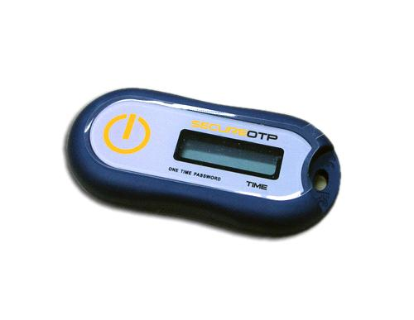
A special application: one time passwords
Server and client are synced on the same point of a pseudorandom sequence
The sequence can advance by keypress or over time (TOTP)
Similar to Keeloq car ignition scheme

Slide 68
Linear Congruential Generator
common iterative technique using:
X_{n+1} = (aX_{n} + c) mod m
given suitable values of parameters can produce a long random-like sequence
suitable criteria to have are:
function generates a full-period
generated sequence should appear random
efficient implementation with 32-bit arithmetic
note that an attacker can reconstruct sequence given a small number of values
have possibilities for making this harder
Notes:
By far the most widely used technique for pseudorandom number generation is the “Linear Congruential Generator”, first proposed by Lehmer. It uses successive values from an iterative equation. Given suitable values of parameters can produce a long random-like sequence, but there are only a small number of such good choices. Note that the sequence, whilst looking random, is highly predictable, and an attacker can reconstruct the sequence knowing only a small number of values. There are some approaches to making this harder to do in practice by modifying the numbers in some way, see text.

Slide 69
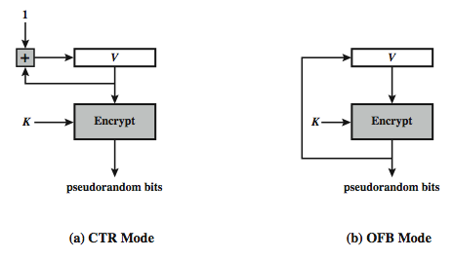
Using Block Ciphers as PRNGs
for cryptographic applications, can use a block cipher to generate random numbers
often for creating session keys from master key
CTR
X_{i} = E_{K}[V_{i}]
OFB
X_{i} = E_{K}[X_{i-1}]
Notes:
A popular approach to PRNG construction is to use a symmetric block cipher as the heart of the PRNG mechanism. For any block of plaintext, a symmetric block cipher produces an output block that is apparently random. That is, there are no patterns or regularities in the ciphertext that provide information that can be used to deduce the plaintext. Thus, a symmetric block cipher is a good candidate for building a pseudorandom number generator. If an established, standardized block cipher is used, such as DES or AES, then the security characteristics of the PRNG can be established. Further, many applications already make use of DES or AES, so the inclusion of the block cipher as part of the PRNG algorithm is straightforward. Two approaches that use a block cipher to build a PNRG have gained widespread acceptance: the CTR mode and the OFB mode. The CTR mode is recommended in SP 800-90, in the ANSI standard X9.82 (Random Number Generation), and RFC 4086. The OFB mode is recommended in X9.82 and RFC 4086. Stallings Figure 7.3 illustrates the two methods. In each case, the seed consists of two parts: the encryption key value and a value V that will be updated after each block of pseudorandom numbers is generated. In the CTR case, the value of V is incremented by 1 after each encryption. In the case of OFV, the value of V is updated to equal the value of the preceding PRNG block. In both cases, pseudorandom bits are produced on block at a time.

Slide 70
Stream Ciphers
process message bit by bit (as a stream)
have a pseudo random keystream
combined (XOR) with plaintext bit by bit
randomness of stream key completely destroys statistic properties in message
C_{i} = M_{i} XOR StreamKey_{i}
but must never reuse stream key
otherwise can recover messages (cf book cipher)
Notes:
A typical stream cipher encrypts plaintext one byte at a time, although a stream cipher may be designed to operate on one bit at a time or on units larger than a byte at a time. In a stream cipher, a key is input to a pseudorandom bit generator that produces a stream of 8-bit numbers that are apparently random. The output of the generator, called a keystream, is combined one byte at a time with the plaintext stream using the bitwise exclusive-OR (XOR) operation. The stream cipher is similar to the one-time pad discussed in Chapter 2. The difference is that a one-time pad uses a genuine random number stream, whereas a stream cipher uses a pseudorandom number stream. But rely on the randomness of stream key completely destroys statistically properties in message. However, you must never reuse a stream key since otherwise you can recover messages (as with a book cipher).

Slide 71
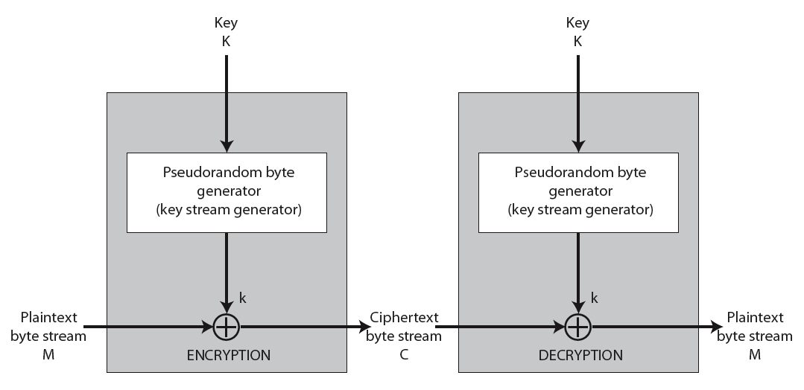
Stream Cipher Structure
Notes:
Stallings Figure 7.5 illustrates the general structure of a stream cipher, where a key is input to a pseudorandom bit generator that produces an apparently random keystream of bits, and which are XOR’d with message to encrypt it, and XOR’d again to decrypt it by the receiver.

Slide 72
Stream Cipher Properties
some design considerations are:
long period with no repetitions
statistically random
depends on large enough key
large linear complexity
properly designed, can be as secure as a block cipher with same size key
but usually simpler & faster
Notes:
[KUMA97] lists the following important design considerations for a stream cipher:
The encryption sequence should have a large period, the longer the period of repeat the more difficult it will be to do cryptanalysis.
The keystream should approximate the properties of a true random number stream as close as possible, the more random-appearing the keystream is, the more randomized the ciphertext is, making cryptanalysis more difficult.
To guard against brute-force attacks, the key needs to be sufficiently long. The same considerations as apply for block ciphers are valid here .Thus, with current technology, a key length of at least 128 bits is desirable.
With a properly designed pseudorandom number generator, a stream cipher can be as secure as block cipher of comparable key length. The primary advantage of a stream cipher is that stream ciphers are almost always faster and use far less code than do block ciphers. A stream cipher can be constructed with any cryptographically strong PRNG.

Slide 73
RC4
a proprietary cipher owned by RSA DSI
another Ron Rivest design, simple but effective
variable key size, byte-oriented stream cipher
widely used (web SSL/TLS, wireless WEP/WPA)
key forms random permutation of all 8-bit values
uses that permutation to scramble input info processed a byte at a time
Notes:
RC4 is a stream cipher designed in 1987 by Ron Rivest for RSA Security. It is a variable key-size stream cipher with byte-oriented operations. The algorithm is based on the use of a random permutation. Analysis shows that the period of the cipher is overwhelmingly likely to be greater than 10^100. Eight to sixteen machine operations are required per output byte, and the cipher can be expected to run very quickly in software. RC4 is probably the most widely used stream cipher. It is used in the SSL/TLS secure web protocol, & in the WEP & WPA wireless LAN security protocols. RC4 was kept as a trade secret by RSA Security, but in September 1994 was anonymously posted on the Internet on the Cypherpunks anonymous remailers list. In brief, the RC4 key is ued to form a random permutation of all 8-bit values, it then uses that permutation to scramble input info processed a byte at a time.

Slide 74
RC4 Key Schedule
starts with an array S of numbers: 0..255
use key to well and truly shuffle
S forms internal state of the cipher
for i = 0 to 255 do
S[i] = i
T[i] = K[i mod keylen])
j = 0
for i = 0 to 255 do
j = (j + S[i] + T[i]) (mod 256)
swap (S[i], S[j])
Notes:
The RC4 algorithm is remarkably simple and quite easy to explain. It uses a variable-length key of from 1 to 256 bytes. The RC4 key schedule initialises the state S to the numbers 0..255, and then walks through each entry in turn, using its current value plus the next byte of key to pick another entry in the array, and swaps their values over. After doing this 256 times, the result is a well and truly shuffled array. The total number of possible states is 256! - a truly enormous number, much larger even than the 2048-bit (256*8) max key allowed can select.

Slide 75
RC4 Encryption
encryption continues shuffling array values
sum of shuffled pair selects "stream key" value from permutation
XOR S[t] with next byte of message to en/decrypt
i = j = 0
for each message byte M_{i}
i = (i + 1) (mod 256)
j = (j + S[i]) (mod 256)
swap(S[i], S[j])
t = (S[i] + S[j]) (mod 256)
C_{i} = M_{i} XOR S[t]
Notes:
To form the stream key for en/decryption (which are identical), RC4 continues to shuffle the permutation array S by continuing to swap each element in turn with some other entry, and using the sum of these two entry values to select another value from the permutation to use as the stream key, which is then XOR’d with the current message byte.

Slide 76
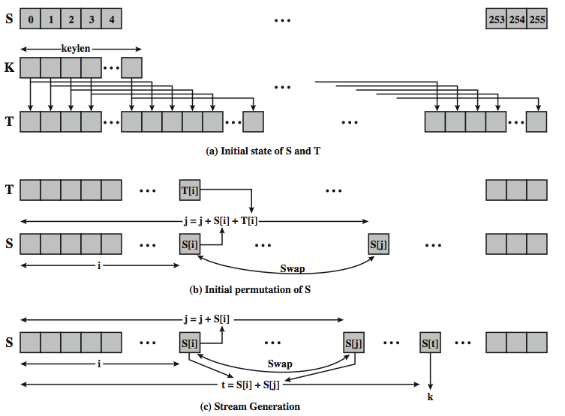
RC4 Overview
Notes:
Stallings Figure 7.6 illustrates the general structure of RC4.

Slide 77
RC4 Security
claimed secure against known attacks
have some analyses, none practical
result is very non-linear
since RC4 is a stream cipher, must never reuse a key
have a concern with WEP, but due to key handling rather than RC4 itself
Notes:
A number of papers have been published analyzing methods of attacking RC4, but none of these approaches is practical against RC4 with a reasonable key length, such as 128 bits.
A more serious problem occurs in its use in the WEP protocol, not with RC4 itself but the way in which keys are generated for use as input to RC4.
Currently RC4 its regarded as quite secure, if used correctly, with a sufficiently large key.

